Slide 1
Thoughts on Persistent Identifier [Development]
Andrew Treloar
Director of Technology
ANDS

Slide 2
ANDS Activity in this area
Researchers and Research Organisations (NLA Party ID)
  http://nla.gov.au/nla.party-513559
Research Projects and Programs
  http://purl.org/au-research/grants/arc/DP0209940
Spatial Location
  Gazetteer (2011)
Research Disciplines
  http://www.abs.gov.au/ausstats/abs@.nsf/0/6BB427AB9696C225CA2574180004463E?opendocument
Datasets and journals
  Identify My Data (Handles now, DataCite DOIs soon)
ands.org.au

Slide 3
Some thoughts on persistence
All of the terms in the phrase Persistent Object Identifier are either poorly defined, or multiply defined/overloaded
So, let’s unpick this a bit:

Slide 4
Persistent
What does the word persistent refer to?
  The object?
    [Persistent Object] Identifier
  The identifier?
    Persistent [Object Identifier]

Slide 5
Persistent definitions
1a. Zool. and Bot. Of a part of an animal or plant (as a horn, leaf, calyx, etc.): remaining attached, not falling off. Of a juvenile or primitive characteristic: retained into adult life.
1b. Continuous, continuing to exist; enduring, lasting; chronic.
2. Continuing firmly or obstinately in some state, opinion, purpose, or course of action, esp. despite opposition, setbacks, or failure; having or characterized by persistence.

Slide 6
Object
One can have persistent identifiers for lots of different things:
  Person (Cliff/Magchiel)
  Organisation
  Object
  Activity
  Service
  …

Slide 7
Object(ive) questions
Assign PID at what granularity?
  Work / Expression / Manifestation / Item
StaticFile, DynamicFile, DBMS
Trustworthiness of the object
Trustworthiness of the assertion about the object
Pointing inside the object?
  ID plus offset?
Who “owns” the binding between identifier and object?

Slide 8
It’s simple!
We are just trying to make a binding between as string of characters and a thing
But…

Slide 9
The Five Persistences
Persistence of object
  Or mechanism to handle its non-persistence
Persistence of identifier
Persistence of binding between identifier and object
Persistence of service to resolve from identifier to object
Persistence of service to allow for updating of binding between identifier and object

Slide 10
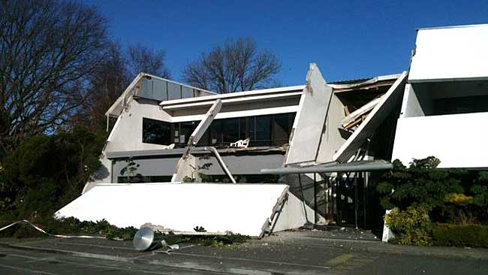
Architecture and brittleness
One way to think about the role of PIDs is as an indirection layer that reduces the level of brittleness in getting from identifiers to objects
  Is this true for the systems we have been looking at during this workshop?
  If not, how can we make it true?
  If so, how can we make it more true?

Slide 11
Closing thoughts
Technology = Easy
Technology({Use|Maintain}) != Easy
Success here requires a combination of:
Policies
Procedures
Sustainability model
Will

Slide 12
Questions? Violent Disagreement?
andrew.treloar.net
andrew.treloar@ands.org.au
@atreloar

